Slide 1

TITLE
ABBS - System
( Advanced Bus Boarding Safety system )

Slide 2
INTRODUCTION
In India, the general populace predominantly relies on buses for transportation to their destinations.
Insufficient bus availability leads to overcrowding, with people even boarding already full buses, which poses safety risks.
To address this concern, the government has taken steps to enhance safety by introducing safety door systems to prevent dangerous overcrowding.
Officials report that Rs 72.25 crore from the central government-sponsored Nirbhaya Fund has been allocated for installing safety equipment on buses.
The primary aim of this allocation is to ensure the safety of women and children who use buses for their travel.

Slide 3
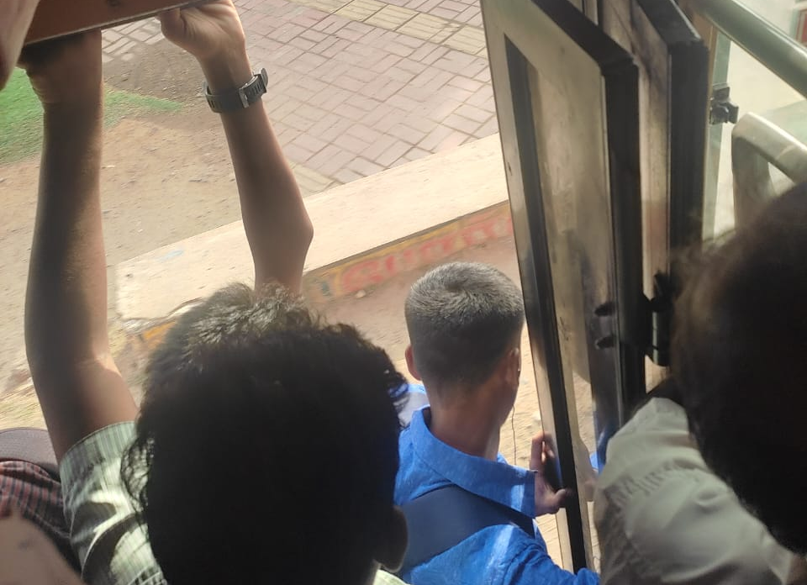
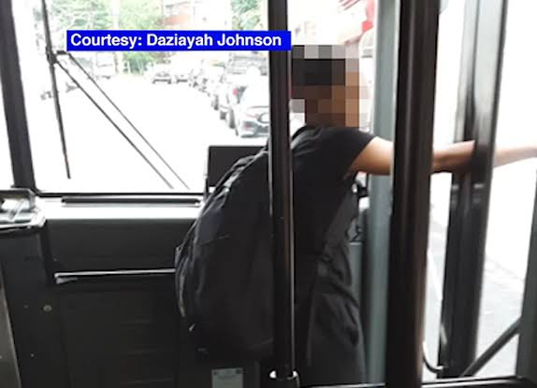
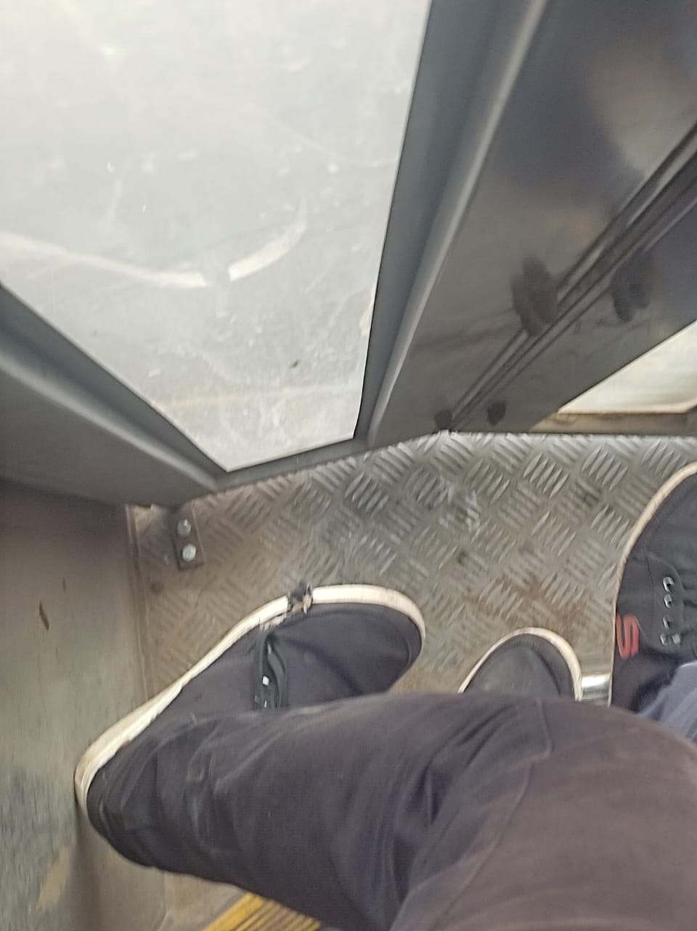
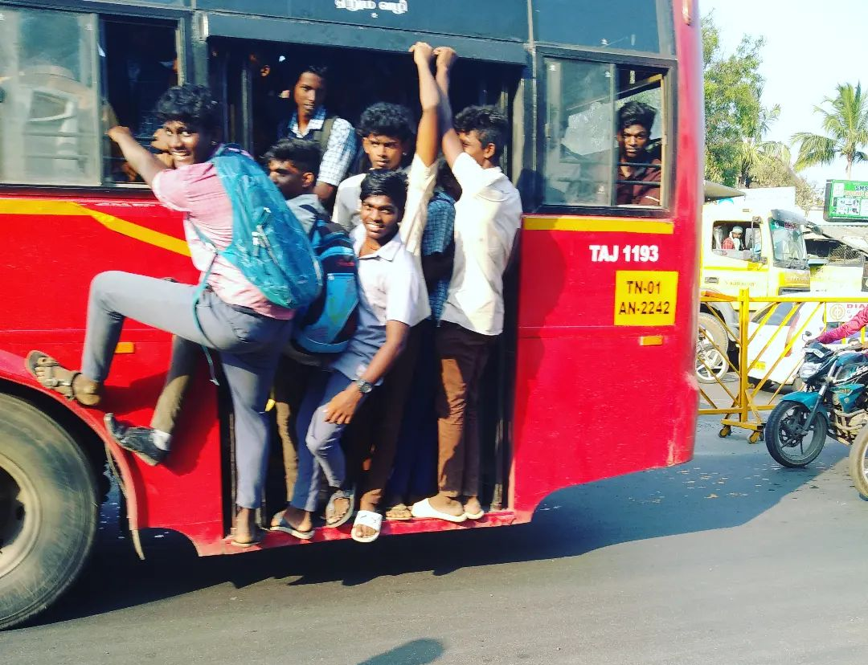
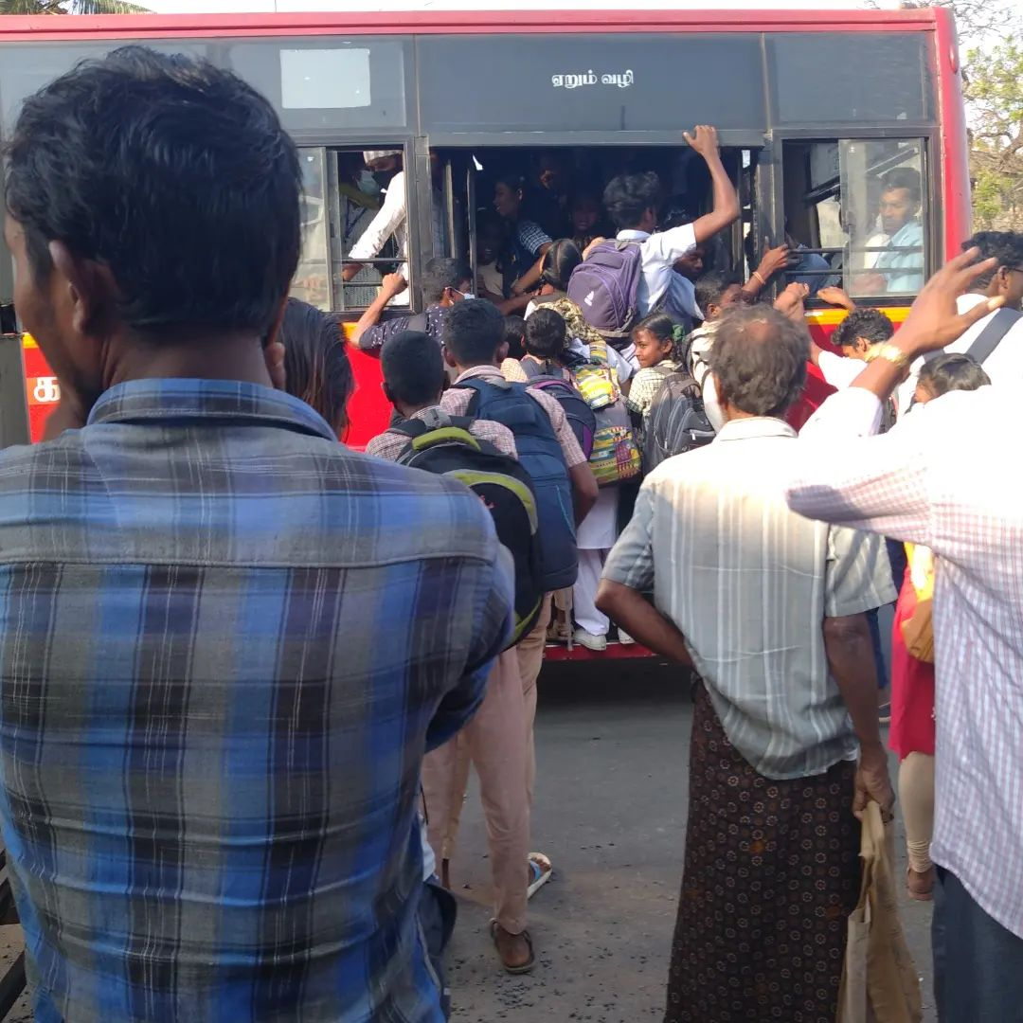
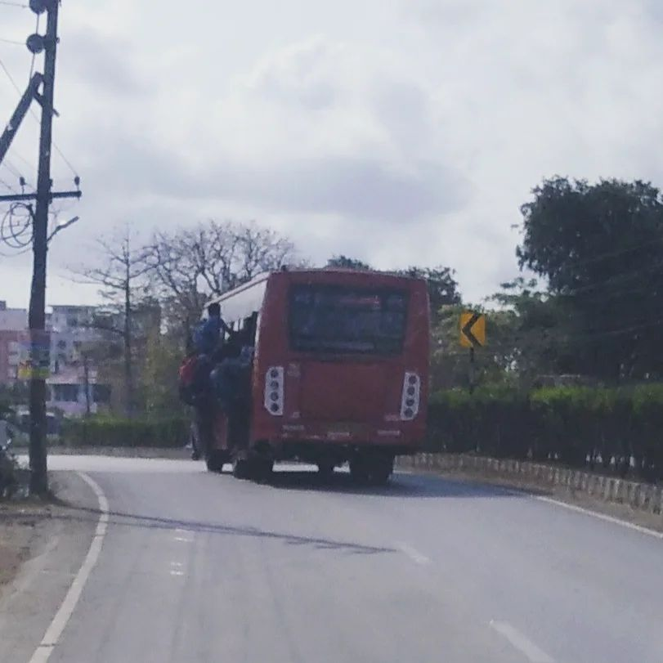
DEFECTS
EXAMPLES:
The door system is designed to prevent congestion and ensure
smooth boarding for both passengers and students.
Effectiveness Challenges:
Despite its intended purpose, the door system's effectiveness is compromised by several factors:
Easy Manual Opening: The doors can be readily opened by hand, indicating a lack of robust security.
Weakness in Design: The doors are not sufficiently sturdy, which diminishes their ability to deter unauthorized access.
Hydraulic Malfunctions: Malfunctions in the hydraulic pump have led to instances where the doors get jammed, impeding normal operation.
Safety Concerns:
The compromised door system has resulted in safety hazards:
Entrapment: Individuals have become trapped due to the malfunctioning doors, leading to limbs getting caught during operation.
Injury Risk: Sharp edges on the doors have posed a risk of injury to passengers and pedestrians during instances of use.

Slide 4
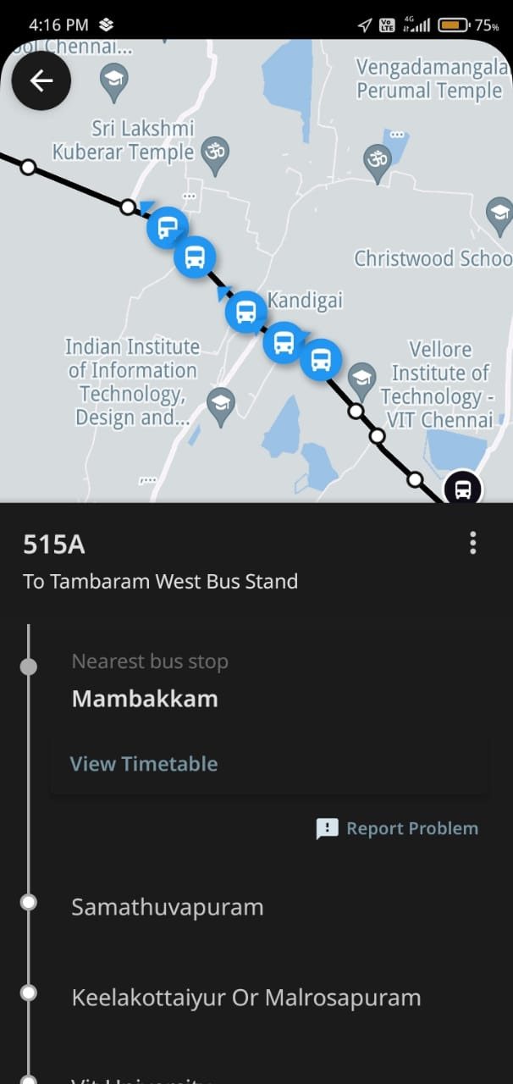
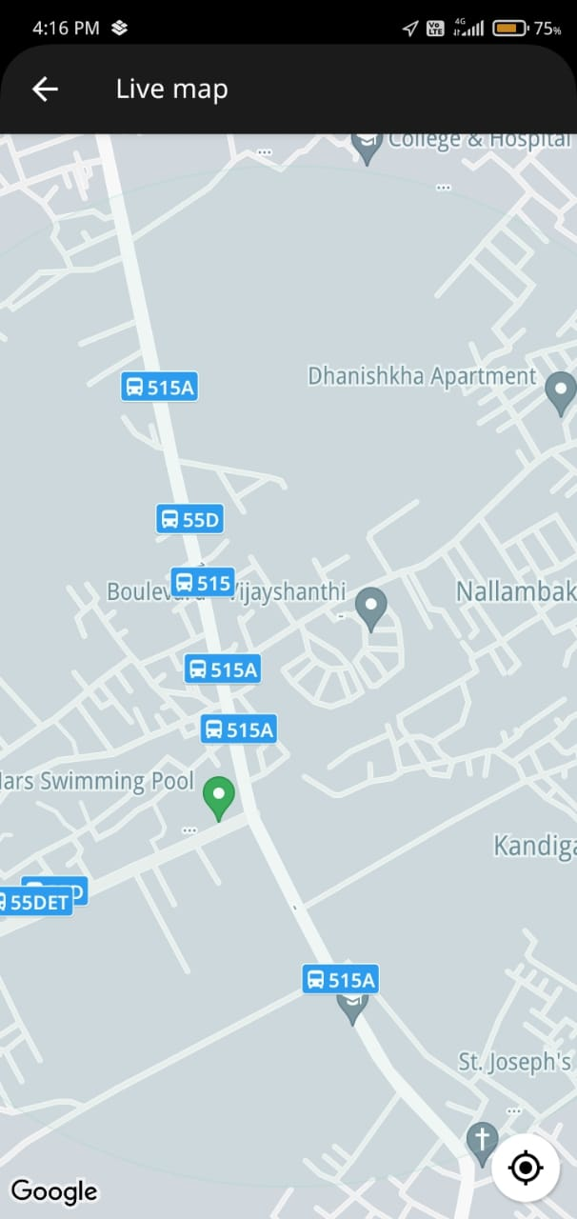
DEFECTS
EXAMPLES:
Observation: Real-time example indicates that buses are not adhering to their scheduled departure times for the designated destinations.
Situation: A notable observation reveals that between the hours of 5 to 6, multiple buses are simultaneously departing from a given location.
Consequence: This concurrent departure pattern leads to a challenging situation where prospective passengers find it difficult to catch the bus as scheduled.
Impact: This situation results in an increased demand for transportation services and contributes to traffic congestion in public areas.

Slide 5

IDEA
BLOCK DIAGRAM
PIR motion sensor
Secondary clutch
Indicator
Microcontroller
ABBS
Staircase
Electro -Hydraulic
Hydraulic tube
Speaker
Power supply
Bus Deceleration

Slide 6

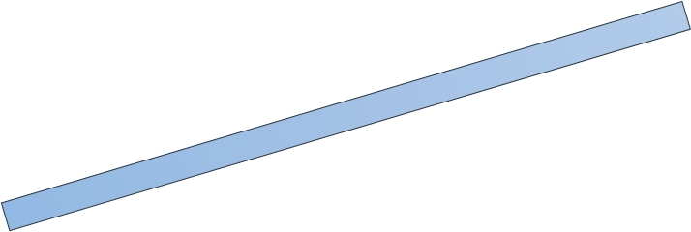
FLOW CHART
Bus decelerates and comes to a halt.
Staircase as a switch engages secondary clutch system
Bus is stationary at bus stop
Passengers approach, and staircase light turns green
Passengers board the bus
Driver releases clutch to initiate bus movement
Motion sensor detects bus movement
Staircase transitions to restricted mode (Green to Red)
Unexpected boarding attempt?
Alarm activated
YES
ABBS - System
NO
Passenger successfully boards the bus
Secondary clutch disengaged
Bus resumes motion

Slide 7
THANK YOU
BETTER CITIZENS, BETTER NATION

